Slide 1

Team Dynamics
K.P.I. Shenesh Perera

Slide 2

What is Team Dynamics?

Slide 3
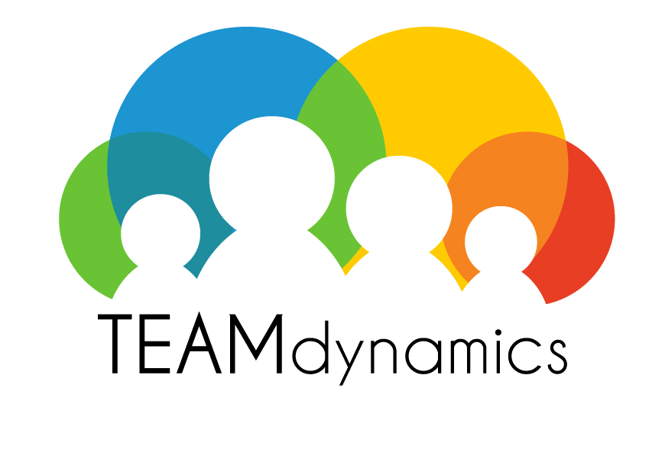
The net of behaviors between or among teams.
Team dynamics are the unconscious, psychological forces that influence the direction of a team’s behavior and performance. They are like undercurrents in the sea, which can carry boats in a different direction to the one they intend to sail.
Team dynamics are created by the nature of the team’s work, the personalities within the team, their working relationships with other people, and the environment in which the team works.
Team dynamics can be good - for example, when they improve overall team performance and/or get the best out of individual team members. They can also be bad - for example, when they cause unproductive conflict, demotivation, and prevent the team from achieving its goals.
Figure 1.0, teamdynamicsweb.com, 10/12/2017

Slide 4
How-to: Team Dynamics

Slide 5
Identify a leader
Establish roles and responsibilities and discuss what each person “brings to the table”
Create goals and objectives
Establish an agenda for managing time to complete tasks and meeting
Develop a method to determine how your team will reach agreement
Figure 1.1, teamdynamicsweb.com, 10/12/2017
Notes:
A common mistake is the failure to recognize that any team endeavor requires the identification or emergence of a leader. This person isn’t there to tell people what to do, but to guide the process, ensure a steady supply of resources, coordinate efforts, and assist in cross-functional-teamwork.
Understanding the various functions and responsibilities of the team is critical to success. Taking the time to understand the expertise and special interests of team members will allow you to match people with their capacity to complete the project tasks.
In any team, recognizing and understanding the goal is paramount. All organizations have long-term goals, and project teams must set and understand technical and process goals.
Teams that effectively manage their time achieve better results.
Every day people make decisions quickly – from what to wear to what to have for breakfast – individuals use rational and irrational methods to make decisions. However, when two or more people (any team or committee) attempt to make the simplest decision without agreement, chaos results.

Slide 6
Establish ground rules for meetings
Ensure proper and timely use of quality tools
Immediately deal with maladaptive behaviors, with consequences included
Quickly start each project or task
State what’s working, as well as how to improve what’s not
Figure 1.2, teamdynamicsweb.com, 10/12/2017
Notes:
“An ounce of prevention is worth a pound of cure.” As it relates to teams, no truer words apply. When teams meet, there should be a set of standards that establish how team members behave toward one another. This will not only ensure courtesy, but also an effective and efficient use of your team’s time together.
Teams must have knowledge (and accessibility) to utilize and comprehend the quality tools needed for each project or task.
No matter how well a team prepares for maladaptive behavior and attempts to prevent it, such behavior will occur. This is particularly the case on teams! When these maladaptive behaviors are ignored and left to fester, they’re like a dead body left to rot in the living room. It looks and smells progressively worse, and no one will want to deal with it.
Teams waste a lot of time before the actual work gets done. Better results in project teams can come in the initial phase if project teams have project management expertise.
Teams need to understand that problems don’t equal solutions. Solutions = Solutions. Teams must quickly acknowledge problems when they exist, then work to determine what will take the place of the problem.

Slide 7

Large Image slide
Figure 1.4, http://blog.practiceplan.co.uk, LEWIS MOODY, 11/11/2016

Slide 8
Videos to understand Team Dynamics better

Slide 9

If video doesn’t load, click here

Slide 10
If the video doesn’t work, click here

Slide 11
What is good team dynamics?

Slide 12
A team with positive team dynamics tend to have team members who trust each other.
They can work towards collective decisions and they are held accountable for outcomes.
A team with good team dynamics may be constructive and productive, and it may demonstrate mutual understanding and self-corrective behavior.
On the other hand, poor team dynamics can be disruptive for successful decision making and work outcomes.
Team dynamics matter because they impact things like creativity, productivity and effectiveness.
Since team work is integral to organization, for business leaders, addressing group dynamics can lead to better work outcomes, customer satisfaction and an improved bottom line.
Figure 1.5, teamdynamicsweb.com, 10/12/2017

Slide 13
What is bad team dynamics?

Slide 14
A group of people who dislike working with each other.
The common causes behind poor group dynamics are:
Weak leadership
Authority and groupthink
Free-riding
Blocking behaviors
Evaluation apprehension
Figure 1.6, teamdynamicsweb.com, 10/12/2017
Notes:
Weak leadership, where the team lacks a strong leader, can pave the way for a dominant team member to take over, resulting in a lack of direction and conflict. Excessive deference to authority can have a stagnating effect of teams as people would rather agree with the leader than offering innovative ideas and opinions. Groupthink can have a similar effect.
Aggressive, negative, withdrawing, recognition-seeking and even joking behaviors can block the flow of information in the team.
Some team members taking it easy at the expense of other colleagues can lead to poor group dynamics and outcomes.
Team members may hold back their opinions and ideas as result of feeling they are being judged harshly by other team members.

Slide 15
How to improve & maintain team dynamics?

Slide 16
Address problems quickly
Create a team motive
Enhance team culture
Build communication
Always pay attention
Figure 1.7, teamdynamicsweb.com, 10/12/2017
Notes:
If you see a team member engaging in unhelpful behaviour, work to address it quickly. Speak to the team member directly and invite him or her to reflect on the behaviour and how it can be changed to support the team’s goals. Teams and individual team members need a strong focus to thrive. If you create a team charter and offer clearly defined roles, you could motivate team members to address their responsibilities and work together more effectively.
Deliberately build a supportive team culture. Use team-building exercises to encourage stronger relationships between individual team members. Create a workplace that supports employee well-being, success and enthusiasm for work.
Give your team tools to drive open communication and encourage team members to communicate clearly to each other. Keep team members updated about project changes and news, and they will feel included and alerted to what is going on.
As part of the organisation’s leadership, you should always be paying attention to your team and know what is going on. Look out for unacceptable behaviours such as bullying, groupthink and freeriding so you are ready to address them right away.

Slide 17
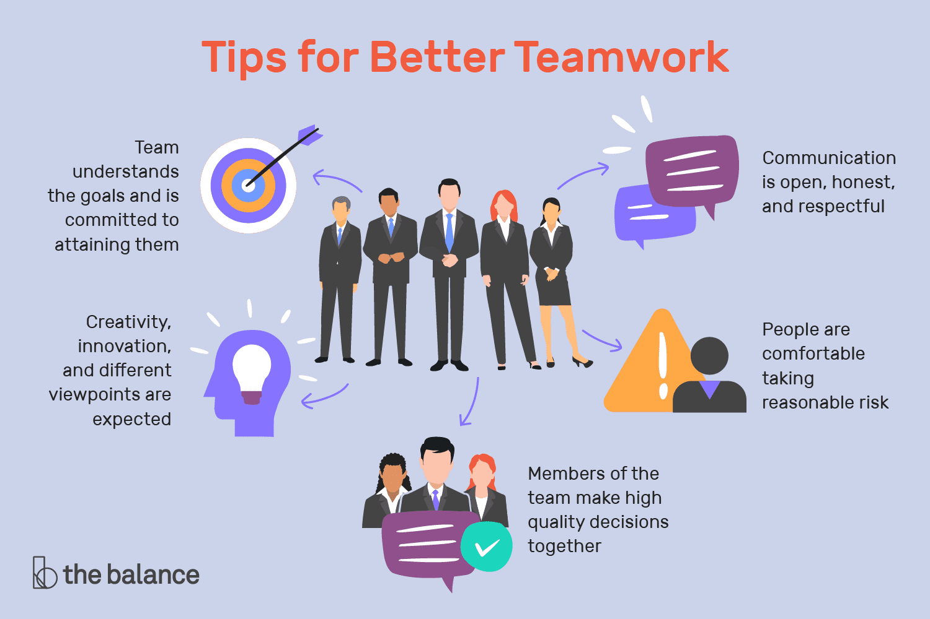
Large Image slide
Figure 1.8, thebalancecareers.com, MR. GEORGE, 22/08/2014

Slide 18




THANK YOU
IDM
K.P.I. Shenesh Perera
+94 0761964698
sheneshperera23@gmail.com

